Slide 1
Cover
See additional samples in 2021 Extra Slide Samples on Inside Dell

Slide 2
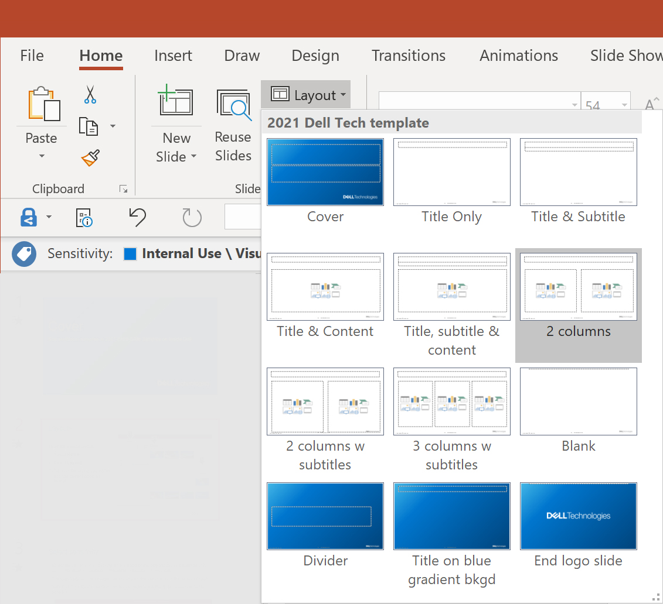
Layouts
1
2
To select a page layout:
Select Home
Select Layout
Click on the layout you prefer and the current page will format
3

Slide 3
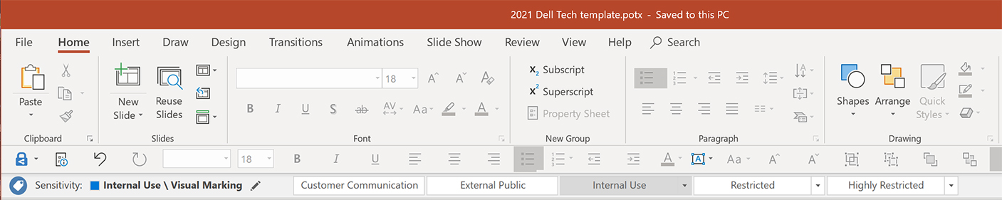
Select sensitivity
Select the sensitivity by clicking on the appropriate designation in the sensitivity bar — the label will appear in the lower left corner of the page
The sensitivity can be changed by clicking on the pencil icon in the sensitivity bar
Note that if the Customer Communication or External Public is chosen, no label appears

Slide 4
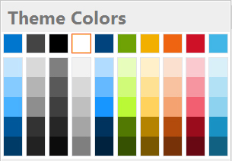
The color palette
Included in the PowerPoint palette slots:
Dell Blue
PMS 2174
RGB 0-118-206
Carbon
PMS Cool Gray 11
RGB 68-68-68
Black
RGB 0-0-0
White
RGB 255-255-255
Midnight
PMS 295
RGB 0-68-124
Green
PMS 376
RGB 110-162-4
Yellow
PMS 7408
RGB 242-175-0
Orange
PMS 151
RGB 238-100-17
“Hyperlinks” are Dell Blue
Not in PowerPoint palette slots but part of the Dell palette:
Red*
PMS 186
RGB 206-17-38
Light Blue
PMS 298
RGB 65-182-230
Gray
PMS Cool Gray 8
RGB 128-128-128
Granite
PMS Cool Gray 3 RGB 200-201-199
Quartz
PMS Warm Gray 1
RGB 238-238-238
Purple
PMS 2603
RGB 110-37-133
Berry
PMS 7425
RGB 183-41-90
Set as Hyperlink followed”
*Note: Use red selectivity, for concepts that align with the color. For example, security-related topics/icons. Do not use red for copy/text or boxes of color.

Slide 5







Use icons and illustrations from the Brand Elements folder on the DAM
Do not use clipart or other unlicensed graphics or logos

Slide 6
Document accessibility
It is important to prepare document content to be accessible to assistive technologies, including screen readers
Best practices to increase accessibility:
Use plain language
Use proper heading structure and hierarchy
Add alternative text to visuals
Provide sufficient color contrast
Provide transcripts or captions for audio and video
Design simplistic tables, charts and graphs
Provide meaningful and descriptive text links
Include document properties

Slide 7
Best practices for leading inclusive meetings
These best practices will help foster inclusive collaboration and ensure all of our team members and partners can be their best and do their best work
BEFORE THE MEETING:
Set an agenda in the invite
Use the built in Accessibility Checkers for PowerPoint, Word, Excel and PDF to ensure your materials are accessible
Share slides and other documents so team members can follow along if they use assistive technology
DURING THE MEETING:
Record meetings
Turn on Closed Captioning
Inquire if there are any preferences before using video or moving backgrounds
In larger meetings, say your name before you speak to ensure everyone knows who is talking
Be descriptive when presenting, refrain from statements like “As you can see here”
Use inclusive language
AFTER THE MEETING:
Send meeting notes to all attendees
Share any materials not provided before the meeting.
Use the built in Accessibility Checkers for PowerPoint, Word, Excel and PDF to ensure your materials are accessible
Notes:
At Dell Technologies, we are committed to enabling collective progress, to drive change for all of our stakeholders to transform lives, cultivate inclusion and advance sustainability. These best practices will help foster inclusive collaboration and ensure all of our team members and partners can be their best and do their best work.

Slide 8
Sample slide layout: title only

Slide 9
Sample slide layout: title & subtitle
Subtitle sentence case

Slide 10
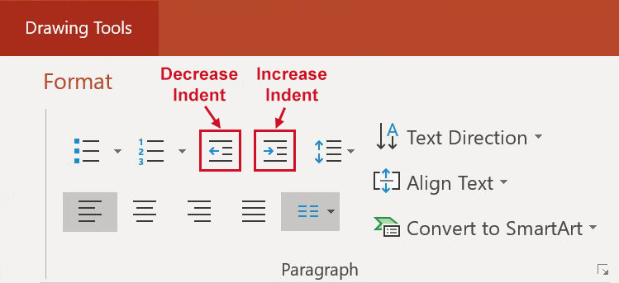
Sample slide layout: title & content
Sample bulleted text
To indent use Drawing Tools tab > Format > Paragraph > Increase Indent button
To decrease indent use Drawing Tools tab > Format > Paragraph > Decrease Indent button

Slide 11
Sample slide layout: title, subtitle & content
Sample subtitle
Sample bulleted text
Sample indent 1
Sample indent 2
Sample bulleted text

Slide 12
Sample slide layout: 2 columns
Sample bulleted text
Sample indent 1
Sample indent 2
Sample bulleted text
Sample bulleted text
Sample indent 1
Sample indent 2
Sample bulleted text

Slide 13
Sample slide layout: 2 columns w subtitles
SAMPLE HEADER
Sample bulleted text indent 1
Sample indent 2: Drawing Tools tab > Format > Paragraph > Increase Indent button
To decrease indent use Drawing Tools tab > Format > Paragraph > Decrease Indent button
Sample indent 3
SAMPLE HEADER
Sample bulleted text indent 1
Sample indent 2: Drawing Tools tab > Format > Paragraph > Increase Indent button
To decrease indent use Drawing Tools tab > Format > Paragraph > Decrease Indent button
Sample indent 3

Slide 14
Sample slide layout: 3 columns w subtitles
SAMPLE HEADER
Sample text indent 1
Sample indent 2: Drawing Tools tab > Format > Paragraph > Increase Indent button
To decrease indent use Drawing Tools tab > Format > Paragraph > Decrease Indent button
Sample text
SAMPLE HEADER
Sample text indent 1
Sample indent 2: Drawing Tools tab > Format > Paragraph > Increase Indent button
To decrease indent use Drawing Tools tab > Format > Paragraph > Decrease Indent button
Sample text
SAMPLE HEADER
Sample text indent 1
Sample indent 2: Drawing Tools tab > Format > Paragraph > Increase Indent button
To decrease indent use Drawing Tools tab > Format > Paragraph > Decrease Indent button
Sample text

Slide 15
Sample blank slide

Slide 16
Sample divider

Slide 17
Sample slide layout: title on blue gradient background

Slide 18
End logo slide

